Slide 1

Housing price Prediction
Made By:
Dinesh sharma

Slide 2
Problem Definition
Houses are one of the necessary need of each and every person around the globe and therefore housing and real estate market is one of the markets which is one of the major contributors in the world’s economy. It is a very large market and there are various companies working in the domain.
The company is looking at prospective properties to buy houses to enter the market. You are required to build a model using Machine Learning in order to predict the actual value of the prospective properties and decide whether to invest in them or not. For this company wants to know:
• Which variables are important to predict the price of variable?
• How do these variables describe the price of the house?

Slide 3
Implementation Steps
Importing Data
Data Cleaning/EDA
Data visualization
Feature Engineering
Removal of Outliers
Model Building
Testing different models and deciding upon the best one

Slide 4
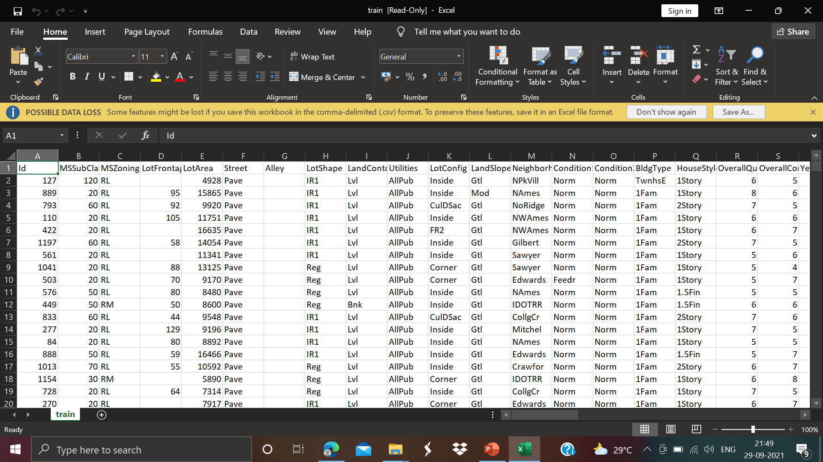
Dataset
Train Dataset

Slide 5
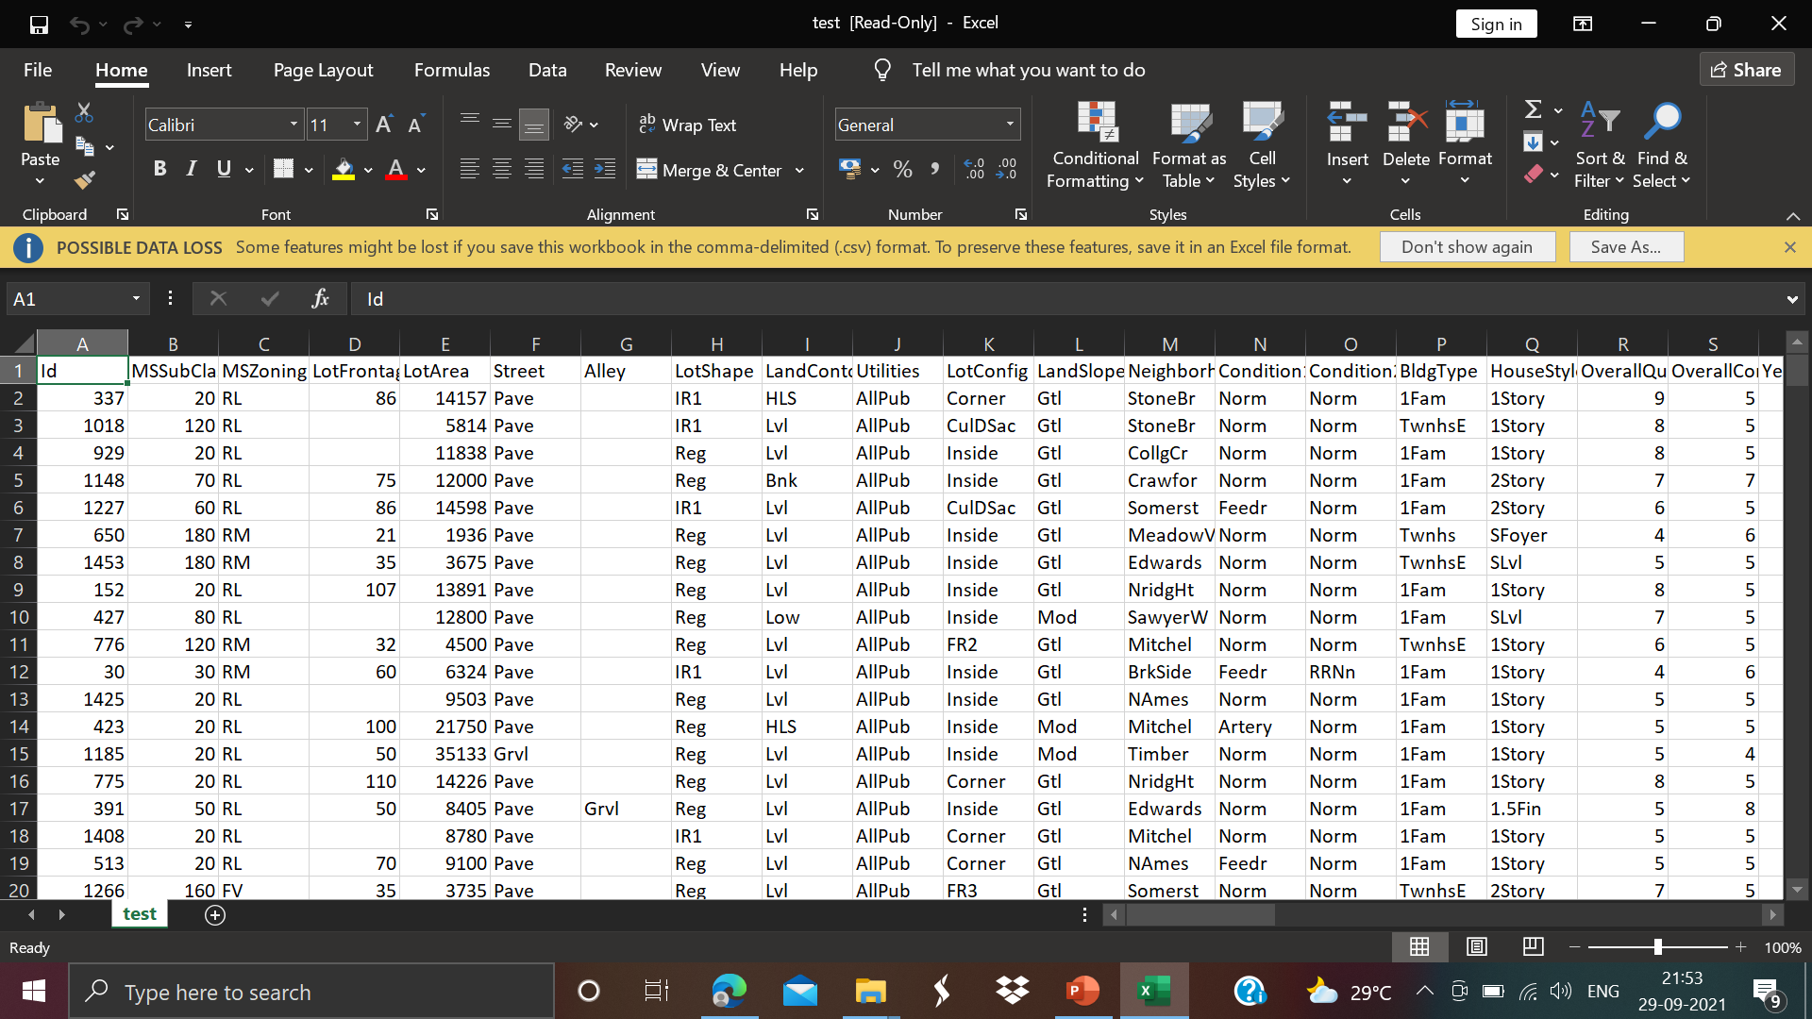
Test dataset
Dataset

Slide 6
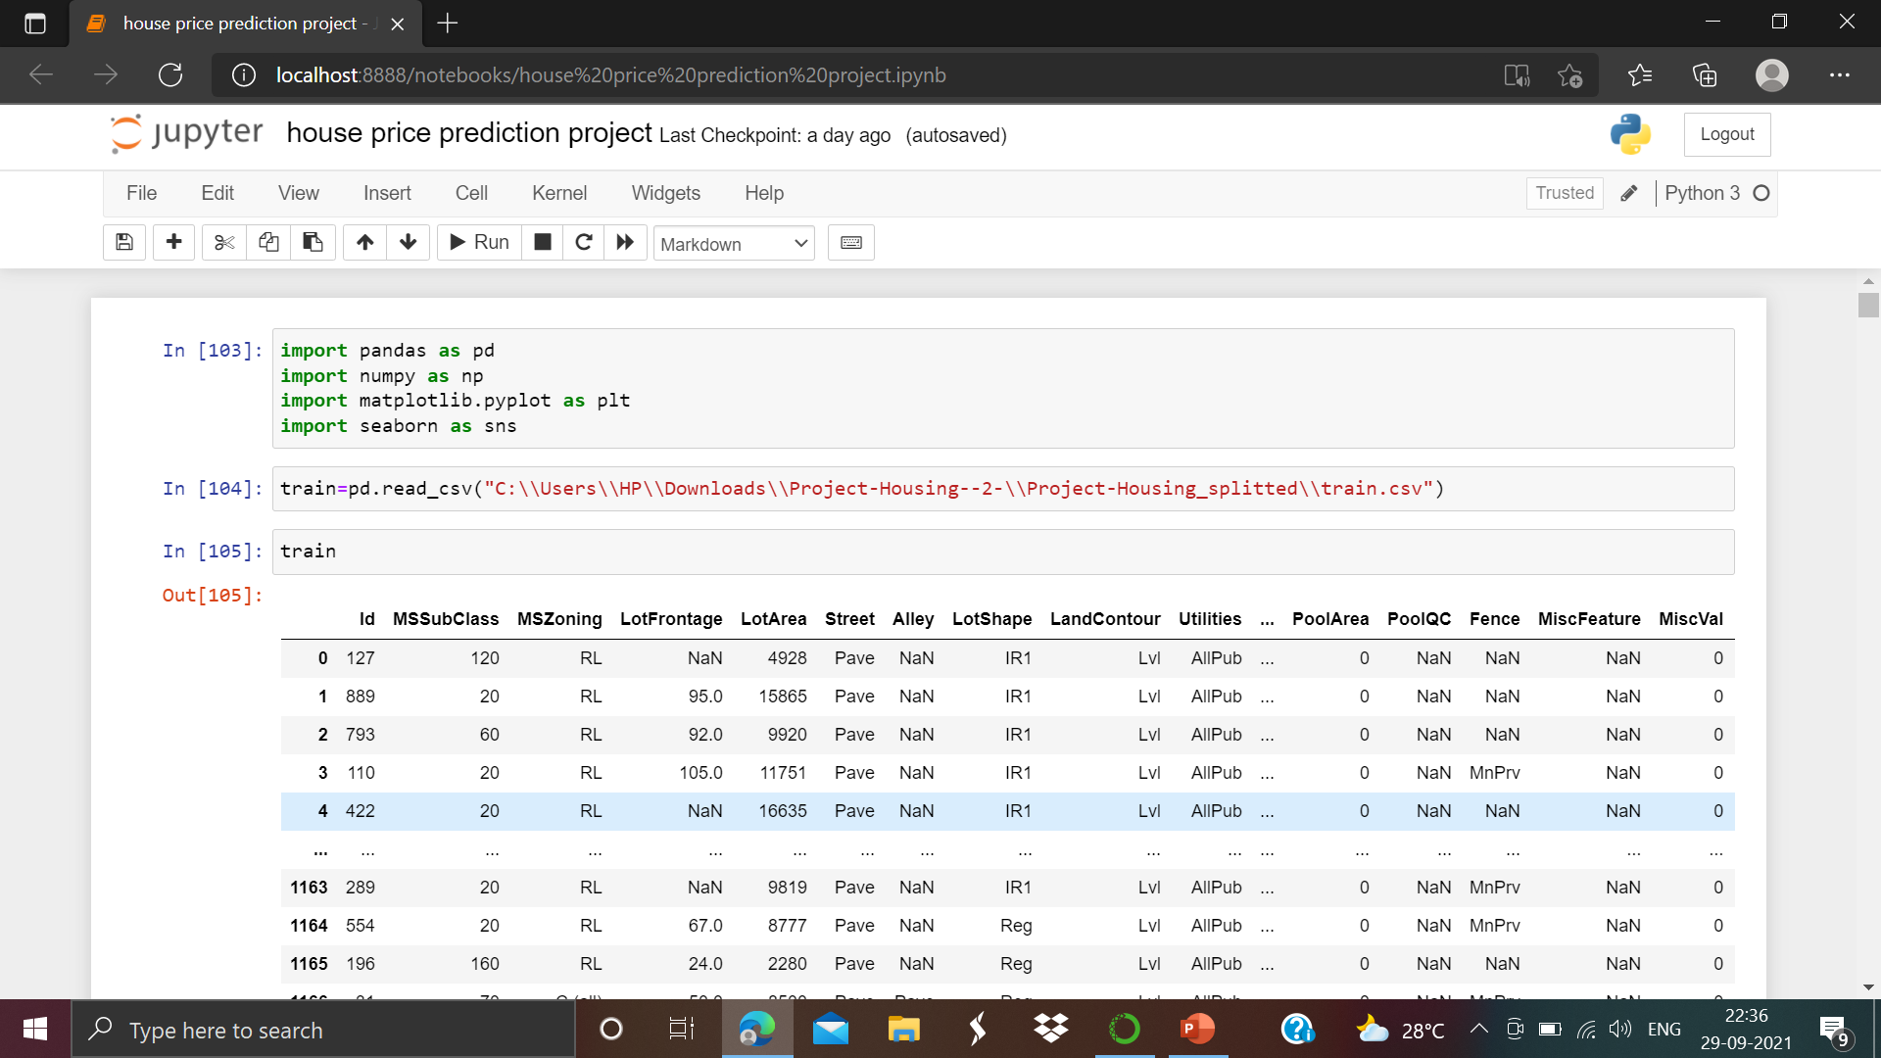
Import the dataset

Slide 7
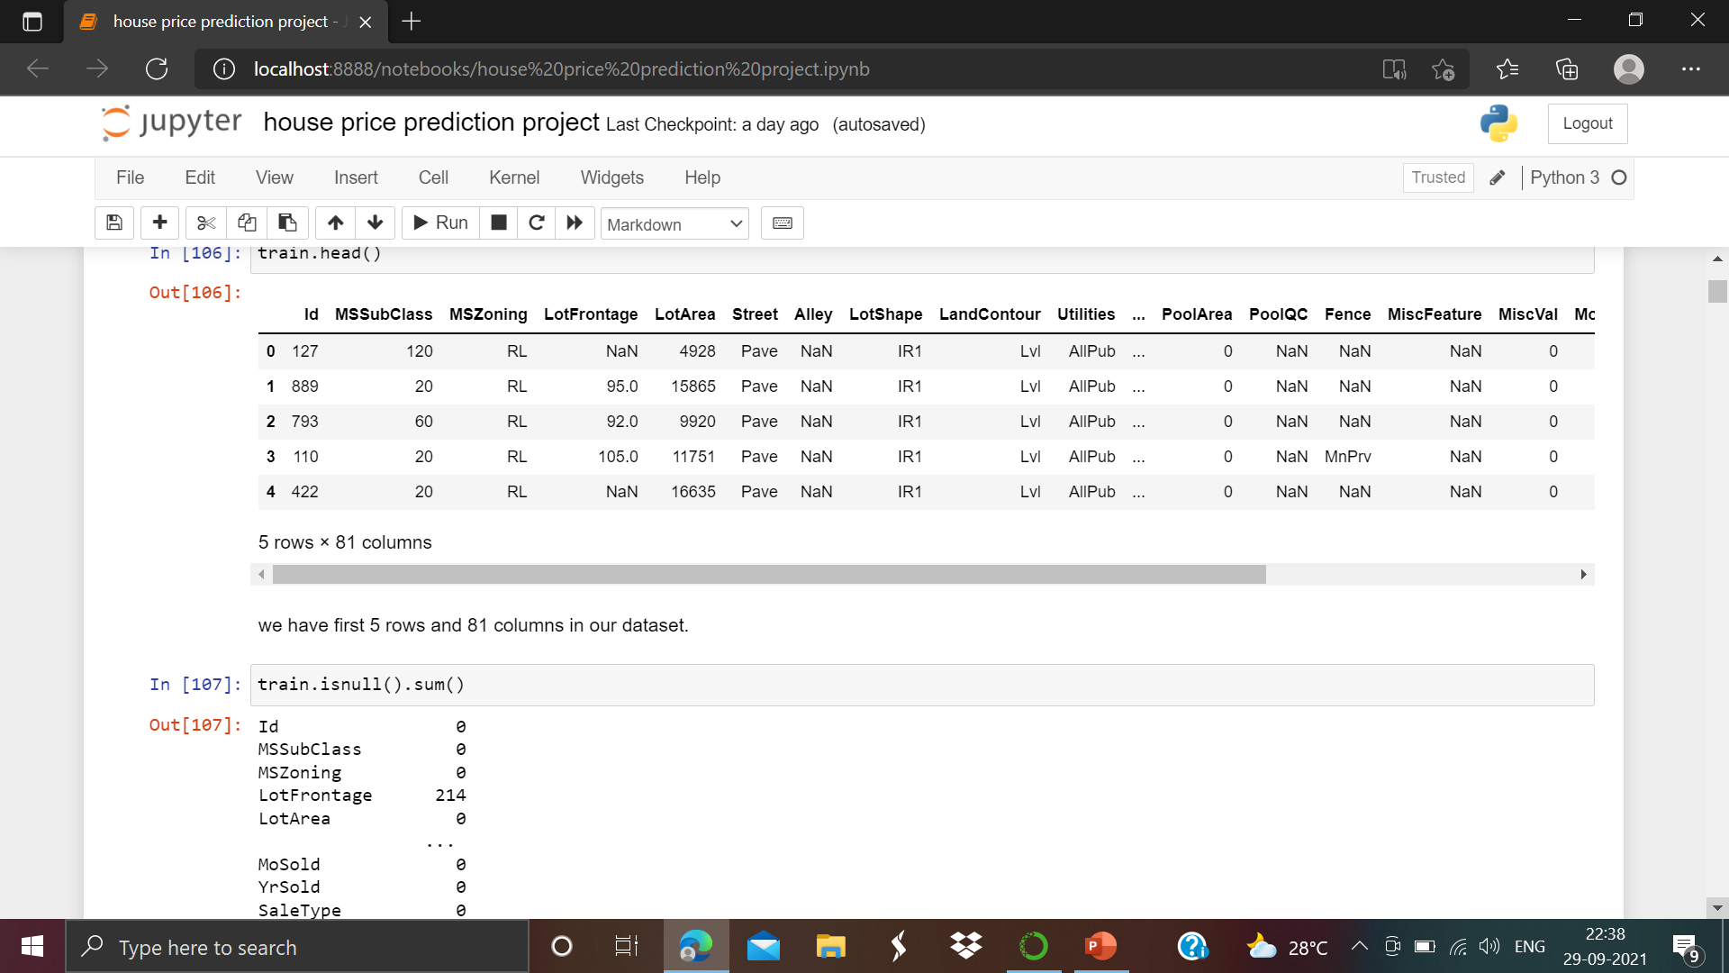
Identify the null/missing values

Slide 8
Data Cleaning Steps
1) Dropping Unnecessary Columns
2) Filling missing values in dataset
3) Dropping remaining rows with missing values
4) Applying Mean and mode function
5) Cleaning Total_Sq_Ft column

Slide 9
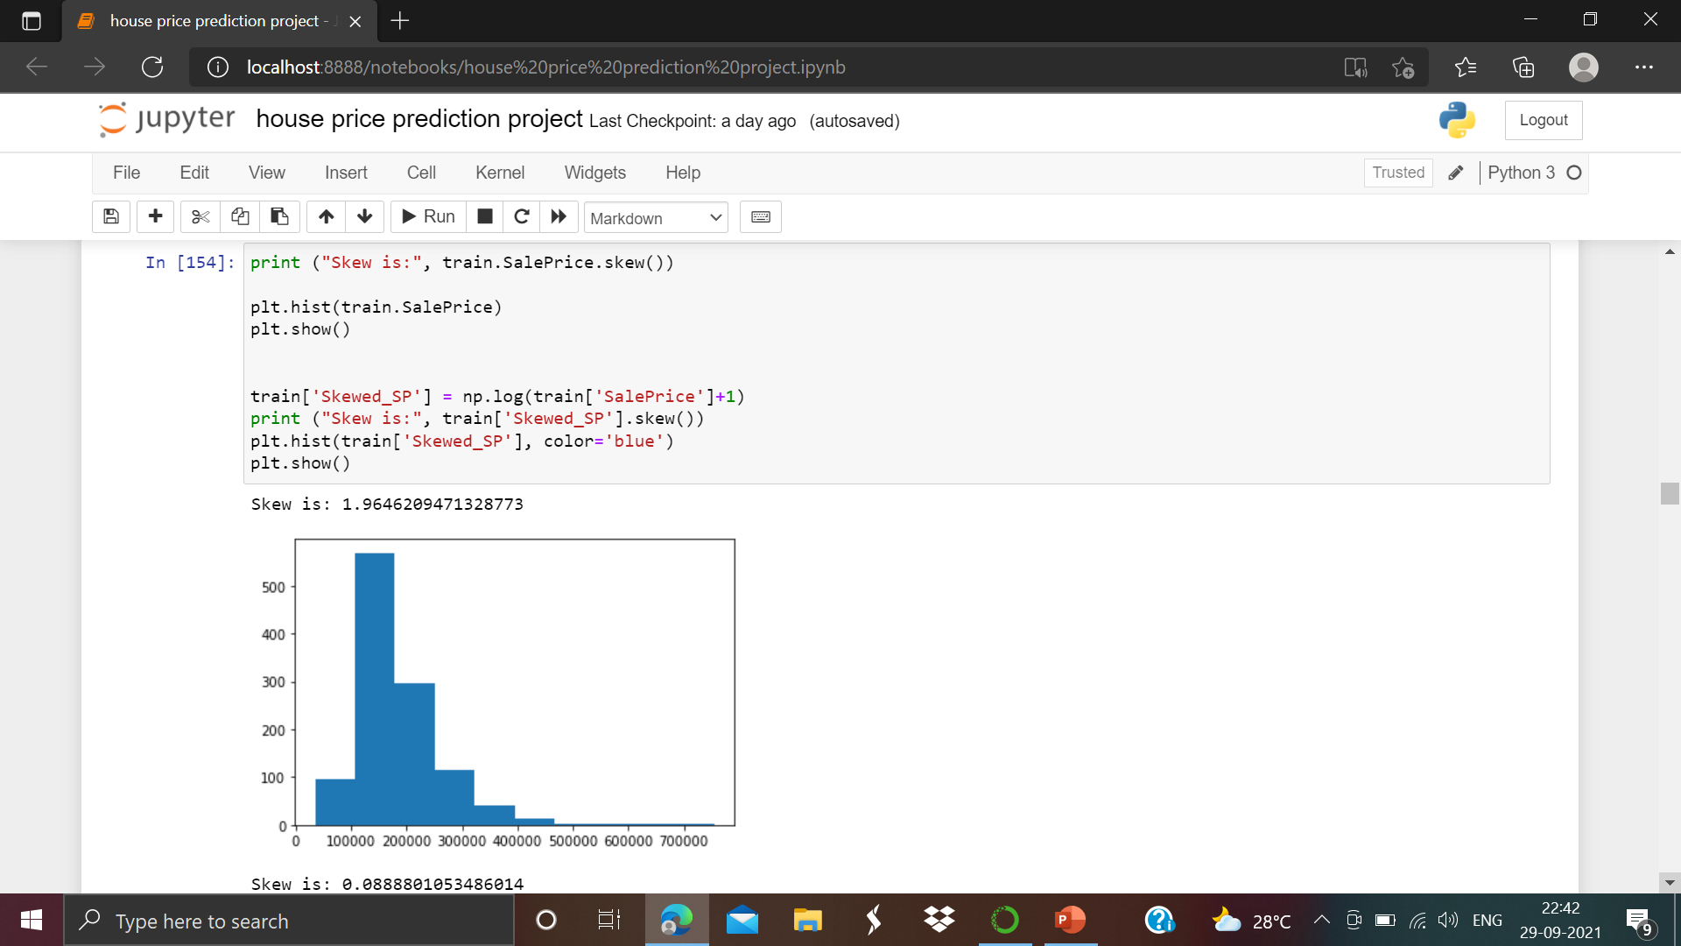
Data visualization
Now we will move to Data visualization part.

Slide 10
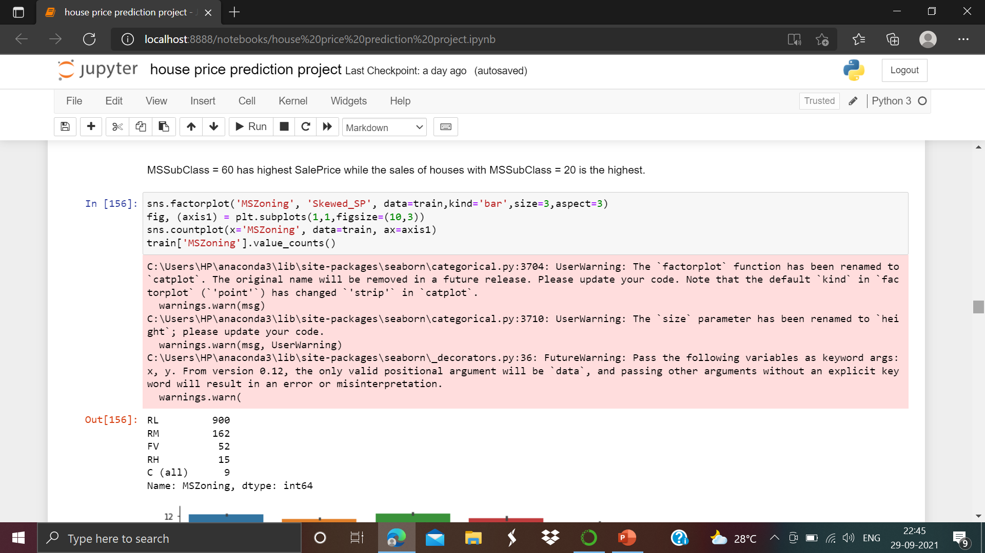
Data visualization

Slide 11
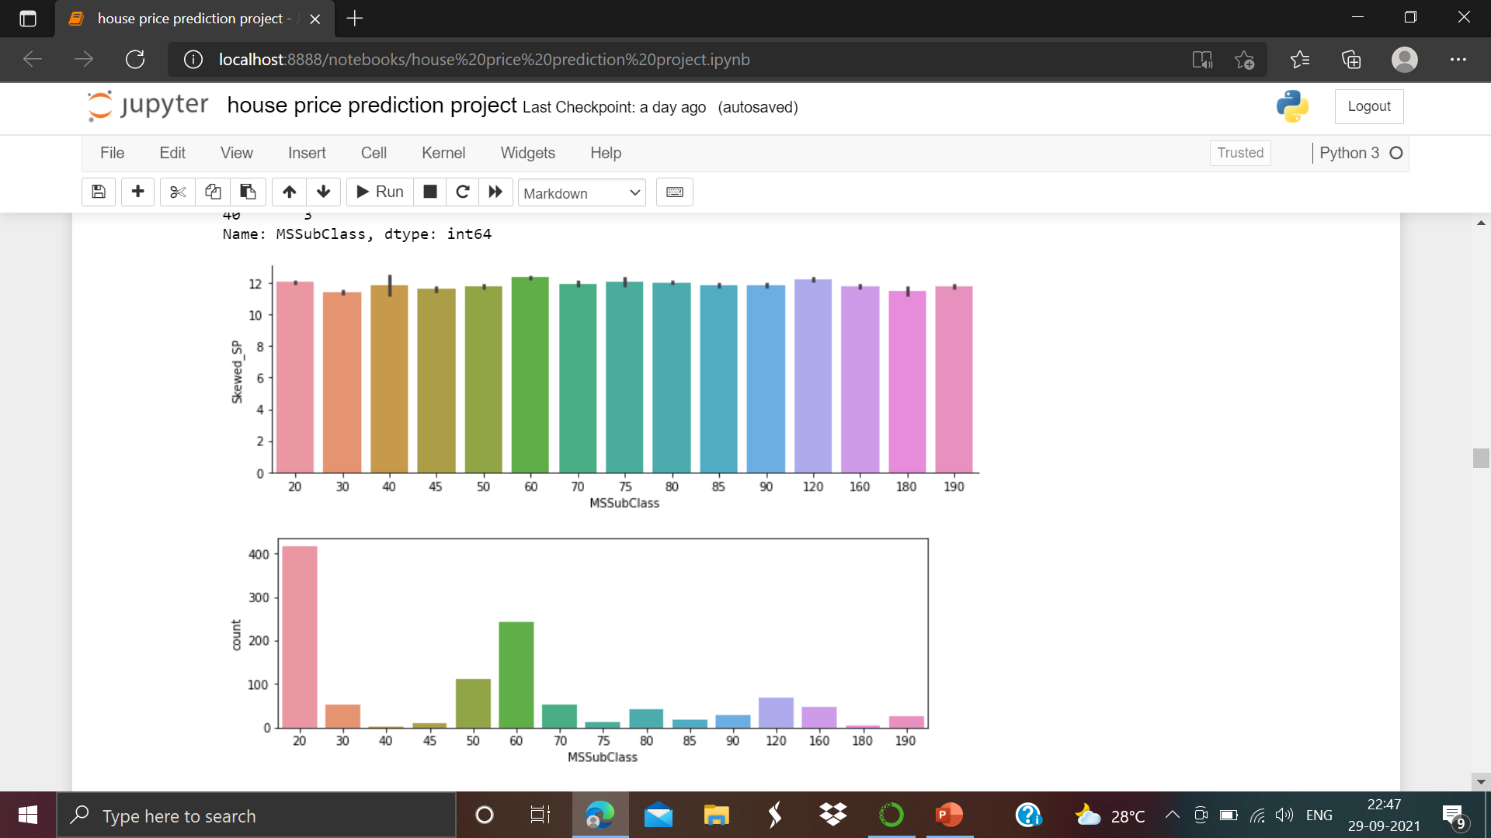
Data visualization MSSubClass = 60 has highest SalePrice while the sales of houses with MSSubClass = 20 is the highest.

Slide 12
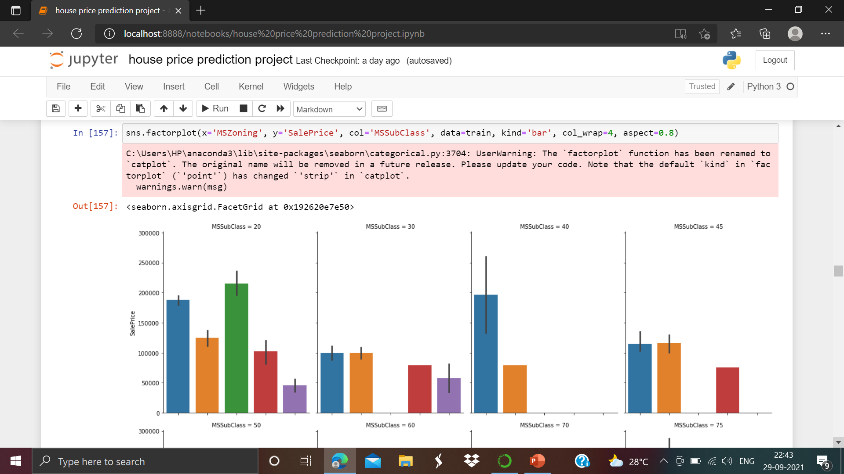
Data visualization

Slide 13
2) Feature Engineering Steps
Let's take a look at some features that may be misinterpreted to represent something it's not.MSSubClass: Identifies the type of dwelling involved in the sale. Also we apply Label encoding for both the train and test dataset.

Slide 14
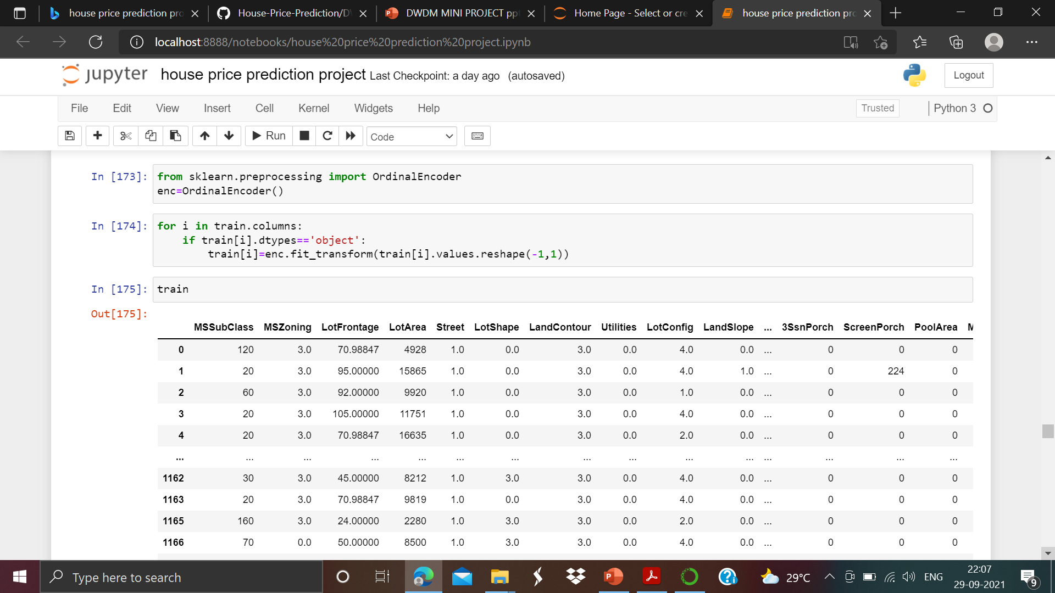
Feature Engineering Steps

Slide 15
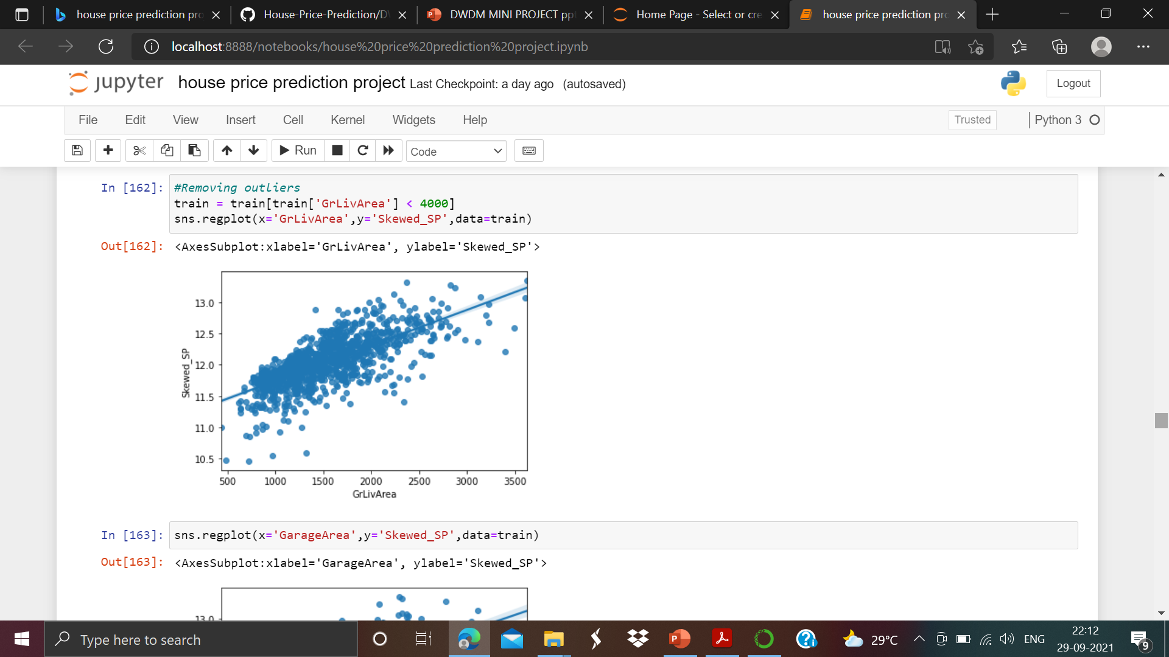
Outliers removal
Now we will move to outliers. We have to remove these outliers from the dataset.

Slide 16
4) Model Building
Split
Split the data into columns which are dependent and independent.
Split
Split the data into Training and Testing.
Build
Build the model.
Use
Use K Fold cross validation to measure accuracy

Slide 17
5) Testing different models and deciding upon the best one
Use GridSearchCV to test and compare different models.
Predict the Price.

Slide 18
A) Linear Regression
Linear regression attempts to model the relationship between two variables by fitting a linear equation to observed data. One variable is considered to be an explanatory variable, and the other is considered to be a dependent variable.
The most common method for fitting a regression line is the method of least-squares. This method calculates the best-fitting line for the observed data by minimizing the sum of the squares of the vertical deviations from each data point to the line

Slide 19
B) Decision Tree
Decision tree builds regression or classification models in the form of a tree structure. It breaks down a dataset into smaller and smaller subsets while at the same time an associated decision tree is incrementally developed. The final result is a tree with decision nodes and leaf nodes.
A decision node has two or more branches, each representing values for the attribute tested.
Leaf node represents a decision on the numerical target.
The topmost decision node in a tree which corresponds to the best predictor called root node.
Decision trees can handle both categorical and numerical data.

Slide 20
C RANDOM FOREST
The random forest classifier is among the most popular classification algorithms. Today, we’ll learn about this robust machine learning algorithm and see how it works. You’ll also learn about its implementation as we’ll share a step-by-step tutorial on how to use the random forest classifier in a real-life problem.
The random forest classifier is a supervised learning algorithm which you can use for regression and classification problems. It is among the most popular machine learning algorithms due to its high flexibility and ease of implementation.

Slide 21
Modeling and Predictions:-
For our models, we are going to use Random forest regressor, Decision tree regressor and linear regression.
We have also calculated the r2 score and cross validation score.

Slide 22
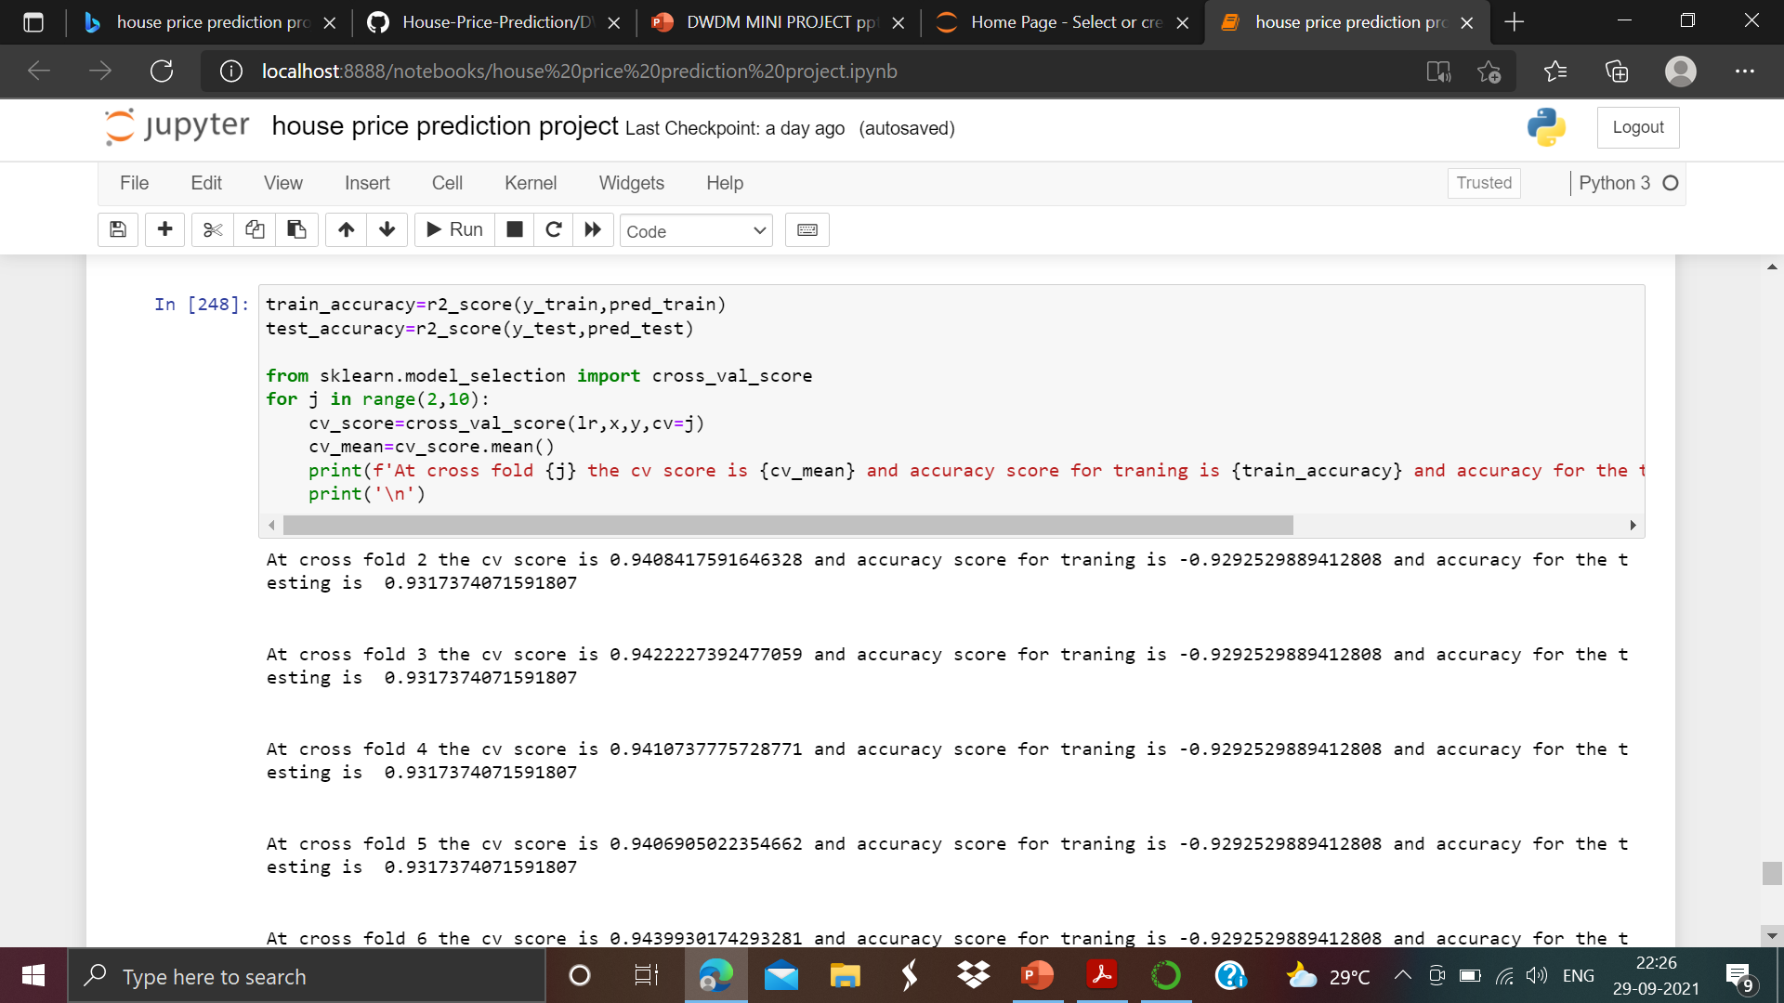
Modeling and Predictions:- As above we can see that since the no. of folds don't have much impact on the accuracy. We have to check the performance of base models by evaluating the cross-validation.

Slide 23
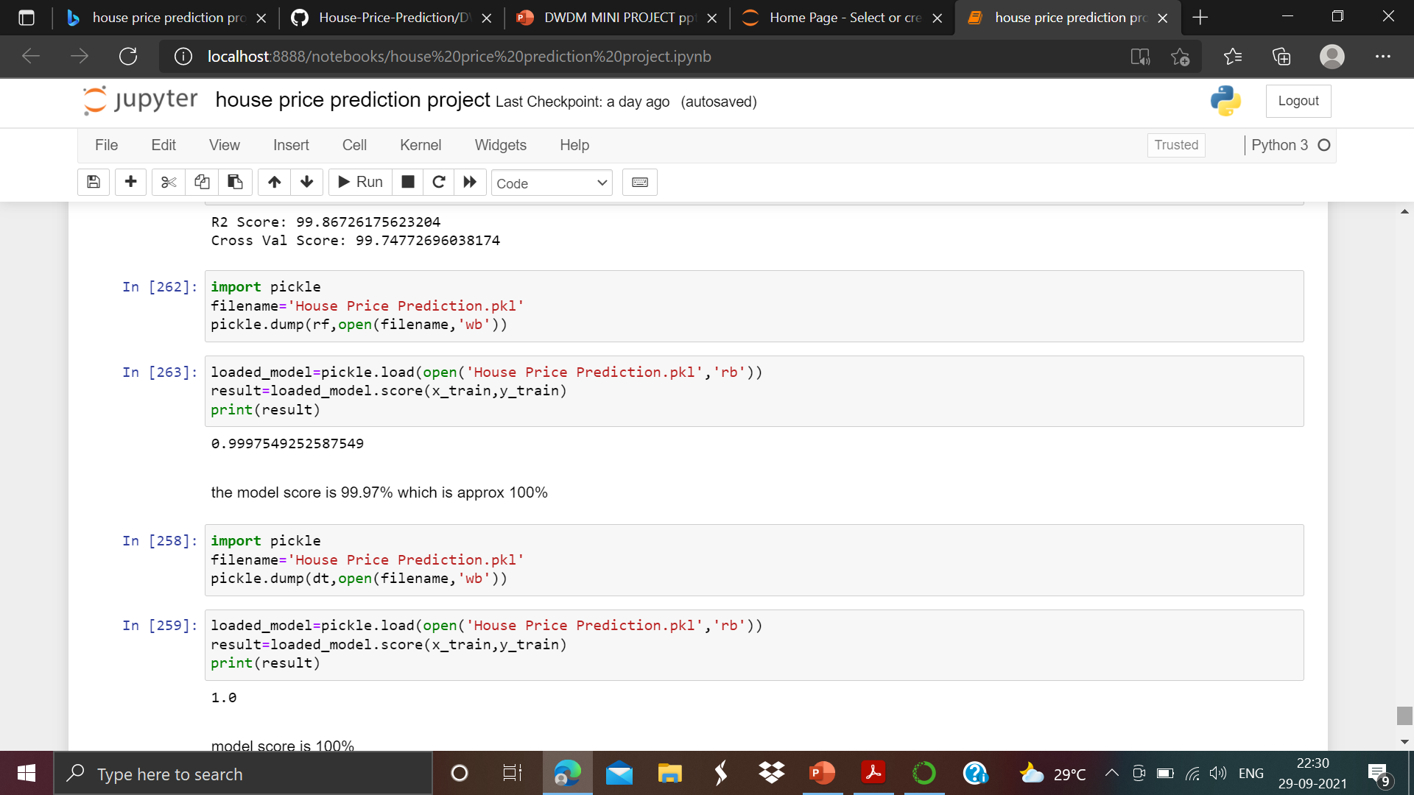
Saving the model
Let’s we will save the our model with file name “House price prediction” in .pkl format. As we can see below:-

Slide 24
Conclusion
As we can see the our train and test data are balanced Decision tree Regressor score is 100% and Random forest regressor test score also comes with approx 100 %
linear regression model score is 96%.
Hence Decision tree and random forest regressor model's are the our best model.

Slide 25
THANK YOU

